Slide 1
An Introduction to Parallel Programming
Peter Pacheco
Chapter 3
Distributed Memory Programming with
MPI
Copyright © 2010, Elsevier Inc. All rights Reserved
Notes:
The University of Adelaide, School of Computer Science
Chapter 2 — Instructions: Language of the Computer

Slide 2
Objectives
  More performance
    Speedup
    Efficiency
    Scalability
    Typical Curves
      Speedup
      Efficiency
      Execution Time
  Assignment #2
10-<number>

Slide 3
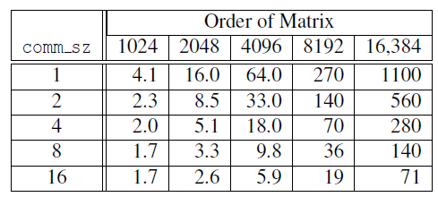
Run-times of serial and parallel matrix-vector multiplication
(Seconds)
Copyright © 2010, Elsevier Inc. All rights Reserved

Slide 4
Run-times of serial and parallel matrix-vector multiplication
Times for comm_sz = 1 are runtimes of the serial program running a single core of the distributed system.
If comm_sz is fixed, and n increased, then the runtimes will increase
For relative small number of processes, doubling n results on roughly a 4-fold increase in runtime.
For Large numbers of processes, this breaks down (no 4 fold anymore)
(Seconds)
For small n, there is very little benefit in increasing comm_sz, see comm_sz =(8,16) and n=1024
At some point, the run-times can actually start to get worse, see (8, 1024) to (16, 1024)
Copyright © 2010, Elsevier Inc. All rights Reserved

Slide 5
Run-times of serial and parallel matrix-vector multiplication
There is a common relationship between the run-times of serial programs and the run-times of corresponding parallel programs
In MPI programs, the parallel overhead typically comes from communication, and it can depend on both the problem size and the number of processes.
Copyright © 2010, Elsevier Inc. All rights Reserved

Slide 6
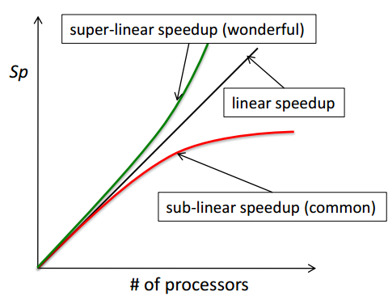

Speedup
Ts: Execution time using a single processor system (best sequential algorithm)
Tp: Execution time using a multiprocessor with p processors
It provides answers to the question of how much faster a multiprocessor system can solve a given problem under consideration
Copyright © 2010, Elsevier Inc. All rights Reserved

Slide 7
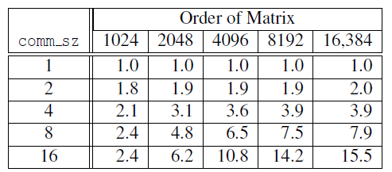
Speedups of Parallel Matrix-Vector Multiplication
Small p, large n
  Almost linear speedup (see comm_sz = 1,2,4,8, and n = 16384)
Large p, small n
  Speedup considerable less than p (see comm_sz = 8, 16, and n =1024, 2048)
Worse case
  Comm_size = 16, n=1024, speedup of 2.4
Copyright © 2010, Elsevier Inc. All rights Reserved

Slide 8

Efficiency
It tells us how long processors are being used on the computation
Copyright © 2010, Elsevier Inc. All rights Reserved

Slide 9
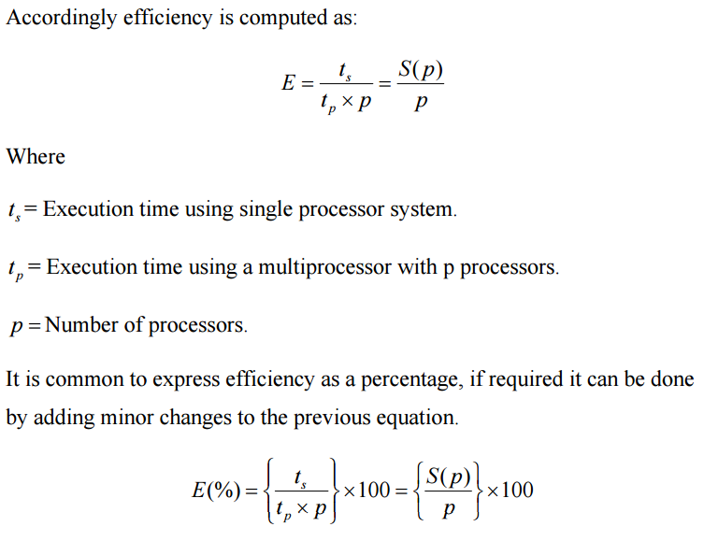
Efficiency
Copyright © 2010, Elsevier Inc. All rights Reserved

Slide 10
Efficiency
So what happens to efficiency when we achieve linear speedup ?
  p/p = 1 → 100% efficiency.
Copyright © 2010, Elsevier Inc. All rights Reserved

Slide 11
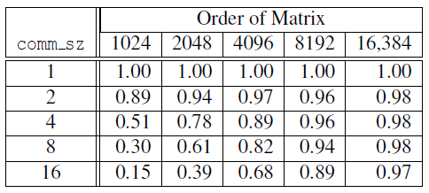
Efficiencies of Parallel Matrix-Vector Multiplication
Copyright © 2010, Elsevier Inc. All rights Reserved

Slide 12
Scalability
A program is scalable if the problem size can be increased at a rate so that the efficiency does not decrease as the number of processes increase.
When discussed, we are usually interested in large values of P
Programs that can maintain a constant efficiency without increasing the problem size are said to be strongly scalable
Programs that can maintain a constant efficiency if the problem size increases at the same rate as the number of processes are sometimes said to be weakly scalable
Copyright © 2010, Elsevier Inc. All rights Reserved

